Slide 1

Crude Oil Price Forecasting
Jose bird

Slide 2
Your best quote that reflects your approach… “It’s one small step for man, one giant leap for mankind.”
- Neil Armstrong

Slide 3
Background
Estimating the future price of crude oil is critical to plan for exploration of oil and gas properties
The time horizon to develop an oil field could be up to 5 years due to the lead time require for engineering, environmental permitting, facility fabrication and construction activities
An estimate of the future crude price at the time of commercial startup is needed to determine if the project can be economically justified

Slide 4
Project Scope
Develop multiple linear regression model to predict crude prices as a function of economic and industry drivers to assist oil & gas companies in their long tern planning activities
Utilize cluster analysis methods to identify key patterns associated with high and low crude prices
Identify key variables impacting crude prices and others to be considered for future work

Slide 5
Analysis Data
The data for this project is available via the St. Louis Fed Bank website (https://fred.stlouisfed.org/) which includes US economic data and price data for several commodities
Data is a compilation of several data sources including Bureau of Labor Statistics (BLS), US Energy information Administration (EIA), US Census Bureau, and the Board of Governors of the Federal Reserve System
The data considered for this study represents average monthly prices and covers the years 2001 through 2020
Explanatory variables considered include US unemployment rate, consumer price index (CPI), housing starts, consumer credit, total capacity utilization, automobile sales, US crude oil stock changes, and other relevant economic indicators.

Slide 6
Methodology
Conduct explanatory analysis to examine mean, variability, and extreme values of dependent and independent variables using the pandas describe method
Examine data distributions using histograms
Examine dependent and independent variable relationships using heatmap correlation matrix
Built multiple linear regression model to predict crude prices using 70% of randomly generated data and test with remaining 30%
Examine data patterns using K-means and hierarchical agglomerative clustering methods

Slide 7
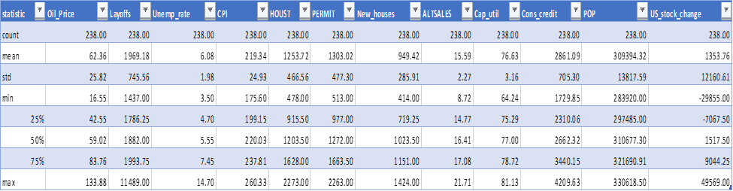
Exploratory Analysis Summary statistics
Average crude price is about 62 $/bbl with maximum value over two times the average
An extreme value observed for layoffs variable and replaced with median value
Gasoline prices have a higher positive correlation with CPI and population which indicates a more direct relationship with these variables vs. crude price

Slide 8
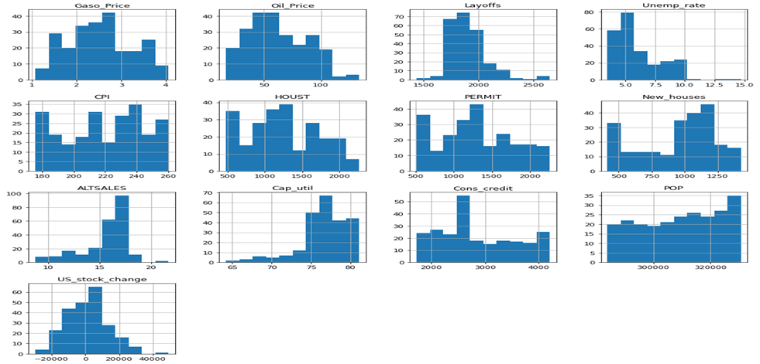
Exploratory Analysis Data Distributions
Crude price close to normally distributed but does exhibit some higher prices exceeding 100 $/bbl
Unemployment rate distribution shows some extreme values exceeding 12%
US crude oil stock changes closely follows a normal distribution
Auto sales shows a left tail indicating periods of low auto sales probably corresponding with low economic activity

Slide 9
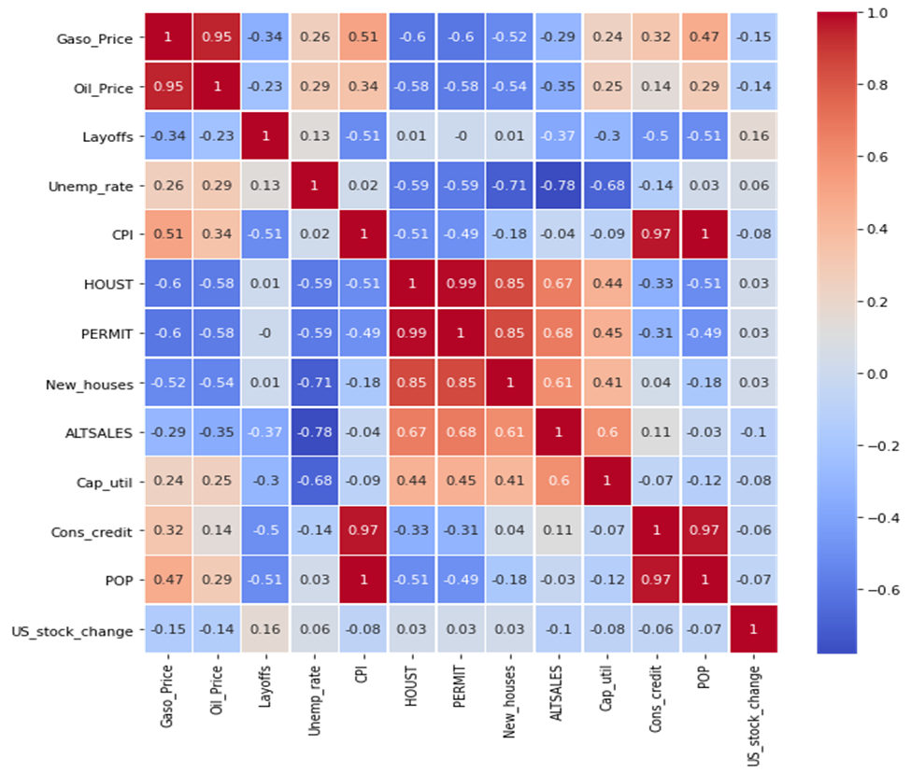
Exploratory Analysis Heatmap Correlation Matrix
The analysis identified high correlation between crude price and gasoline price which was expected
Moderate negative correlation between crude and new construction indexes found
Gasoline prices have a higher positive correlation with CPI and population which indicates a more direct relationship with these variables vs. crude price
House starts, house permits, and new houses highly correlated with each other and represent new construction activity

Slide 10
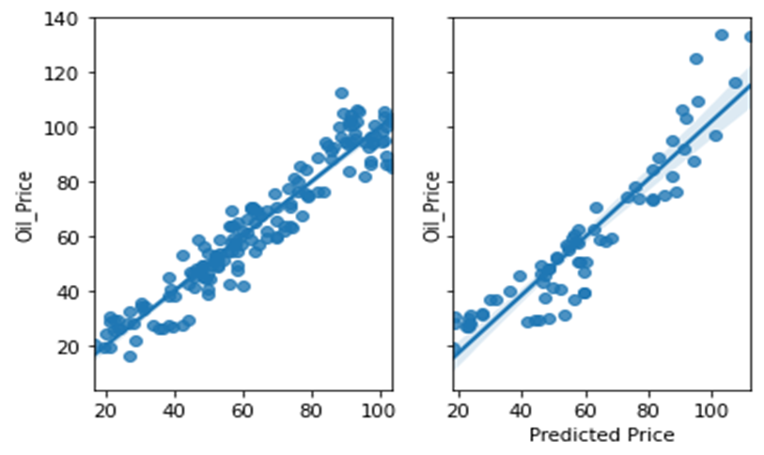
Multiple Regression Results
Multiple linear regression model yielded 0.91 R² using training data
Model yielded 0.86 R² when trained model used to predict test data set
Test data set contained most extreme values some exceeding 120 $/bbl and this were more difficult to predict with trained model which did not see these extreme values
Multiple linear regression analysis resulted in model with high predictive power as evident from high R²

Slide 11
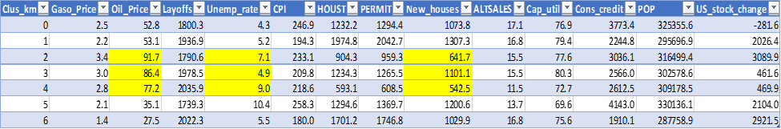
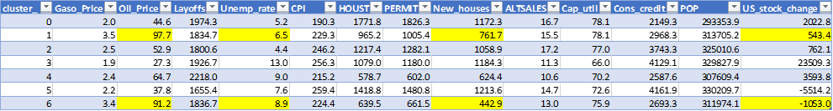
K-Means & Hierarchical Clustering
K-Means
K-Means found two high price clusters with relatively high unemployment rate and low index of new construction activity
Hierarchical clustering found one high price cluster with relatively high unemployment rate and two high price clusters with low index of new construction activity
The cluster analysis identified the degree of association but not causation so further research is needed to identify the best leading indicator for forecasting of crude prices
Hierarchical Clustering

Slide 12
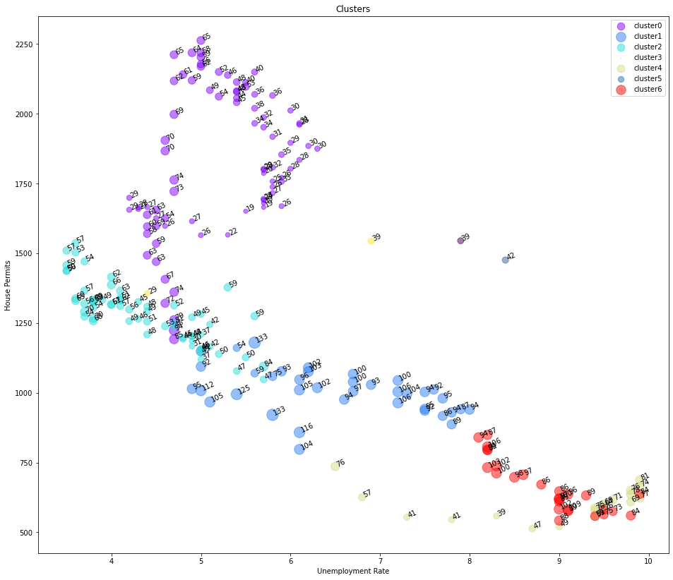
Hierarchical Agglomerative Cluster Analysis House Permits vs. Unemployment Rate by Cluster
Chart shows house permits vs. unemployment rate for the observations in the data set with the clusters highlighted.
The light blue cluster which is cluster 1 above shows relatively low new house permits and middle of the range for unemployment rate.
Cluster 6, on the other hand, shows high unemployment rate and low new house permits.

Slide 13
Discussion
The analysis suggests a more direct relationship between gasoline prices and some of the economic variables when compared to crude price as evident from the correlation matrix.
The analysis yielded a multiple linear regression model with high predictive power but works needs to be expanded to consider lagged terms to better identify leading indicators to generate predictions of future prices.
Cluster analysis showed high prices tended to be associated with periods of low new construction activity and possibly high unemployment rate but further research is needed to confirm this finding.
Additional work is also recommended to experiment with different number of clusters for both clustering methods.

Slide 14
Conclusion
The analysis yielded a model with high predictive power as evident from high R² but further work is required to identify the best leading indicators based on lagged values of independent variables for use in forecasting future crude prices.
Based on this analysis, it is recommended to conduct similar analysis for gasoline prices as the analysis suggests a more direct relationship between gasoline prices and some of the economic variables considered when compared to crude.
Adding more variables to the model recommended such as OPEC production, international petroleum stocks, US GDP, interest rates and a stock market index such as the S&P 500 index.
Other techniques such as CART regression trees should be considered to better account for non-linearities in the data.

